Slide 1
Project : Google Page Rank Algorithm

Slide 2
Group Members
Muhammad Rafay
Faizan Hakim
20K-0180
20k-0290
Aahil
Halani
Anas
Ali
20K-0308
20K-0352

Slide 3
Introduction
PageRank (PR) is an algorithm used by Google Search to rank web pages in their search engine results.
When the first search engines used text based ranking systems to decide which pages are most relevant to a given query.
But then Google Engineers came up with algorithm which gives ranks to the pages on the basis of their ingoing and outgoing links.

Slide 4
Steps to tackle problem
01
02
03
04
Formation of Link Matrix
Finding Eigen Values
Finding Eigen Vectors
Formation of Final Matrix by Applying Probability

Slide 5
PICTORIAL REPRESENTATION OF NODES AND THEIR LINKS
1
2
3
4
5
6
Note: means single outgoing link
means dual ingoing and outgoing links

Slide 6
Formation Of Link Matrix
Links with all pages are created in such a way that if link is there it is represented by 1 and if not then it is represented by 0.
Hence in our case :
PAGE 1 = (0,1,0,1,1,1)
PAGE 2 = (0,0,1,1,0,0)
PAGE 3 = (0,0,0,0,1,0)
PAGE 4 = (0,0,0,0,1,0)
PAGE 5 = (1,0,0,1,0,0)
PAGE 6 = (0,0,0,0,1,0)

Slide 7
Link Matrix
0 0 0 0 1 0
1 0 0 0 0 0
0 1 0 0 0 0
1 1 0 0 1 0
1 0 1 1 0 1
1 0 0 0 0 0
A =

Slide 8
Finding Probability
The PageRank algorithm gives each page a rating of its importance, which is a recursively defined measure whereby a page becomes important if important pages link to it. This definition is recursive because the importance of a page refers back to the importance of other pages that link to it.
One way to think about PageRank is to imagine a random surfer on the web, following links from page to page. The page rank of any page is roughly the probability that the random surfer will land on a particular page. Since more links go to the important pages, the surfer is more likely to end up there.

Slide 9
Final Matrix A
0 0 0 0 1/2 0
1/4 0 0 0 0 0
0 1/2 0 0 0 0
1/4 1/2 0 0 1/2 0
1/4 0 1 1 0 1
1/4 0 0 0 0 0
A =

Slide 10
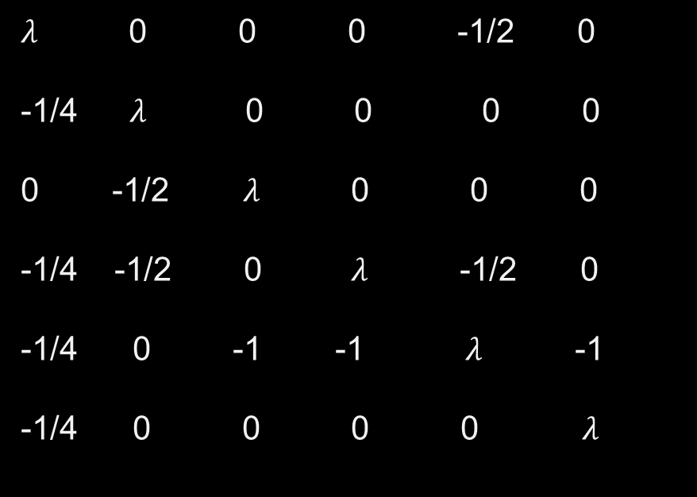

Finding Eigen Values
$λ$ 0 0 0 -1/2 0
-1/4 $λ$ 0 0 0 0
0 -1/2 $λ$ 0 0 0
-1/4 -1/2 0 $λ$ -1/2 0
-1/4 0 -1 -1 $λ$ -1
-1/4 0 0 0 0 $λ$
$λI$ - A =

Slide 11

Solution Of The Eigen Value And Vectors
The Characteristic equation after solving the determinant is found to be :
$8λ$⁴ - 5$λ$² -2$λ$-1
The Eigen Value after solving the above equations are :
$λ$₁ = 1, $λ$₂ = - 0.72031
$λ$₃ = - 0.13985 + 0.3924i , $λ$₄ = - 0.13985 – 0.3924i
Note :
We will only consider real, non negative values as rank will always be a positive real integer.

Slide 12

Eigen Vector From Eigen Values
Eigen Vector corresponding to Eigen Value is found to be
$λ$ = 4 1 0.5 5.5 8 1

Slide 13
Result
As Page 5 has the highest PageRank (8 in the list of eigen vector), we can conclude that it is the most “important”, it will appear at the top of the search results.

Slide 14
Thanks

